Slide 1


Notes:
Briana
Welcome to women who code rva!
So excited to be here hosting our second event during RVA tech week!
Are thrilled to be showing the screening of code

Slide 2
“DEAR WOMEN,
WE NEED YOU”
-The Tech Industry
Notes:
Michele --

Slide 3
Tech jobs are growing. Fast.
THE MARKET IS NOT PREPARED TO FILL 600,000+
Notes:
Some sources estimate that up to 1M jobs will go unfilled by 2020

Slide 4
51% of professional occupations
26% of 3.8 million computing jobs
4.2% of investing Venture Partners
7% of Venture Capital recipients
Notes:
Michele -- There’s a huge opportunity! NOTE: use the positive when talking about this. Today, women hold 51% of professional occupations, but only about a quarter of computing jobs. The opportunity is even greater amongst venture partners where women represent less than 5% and Venture Capital recipients where women represent about 7%.

Slide 5


OUR MISSION Inspiring women to excel in technology careers.
Notes:
So - who are we, and what is WWCode doing to help women leverage the opportunities in tech?

Slide 6
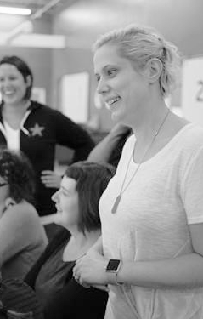
60
cities
20
countries
Notes:
We are a global non profit

Slide 7
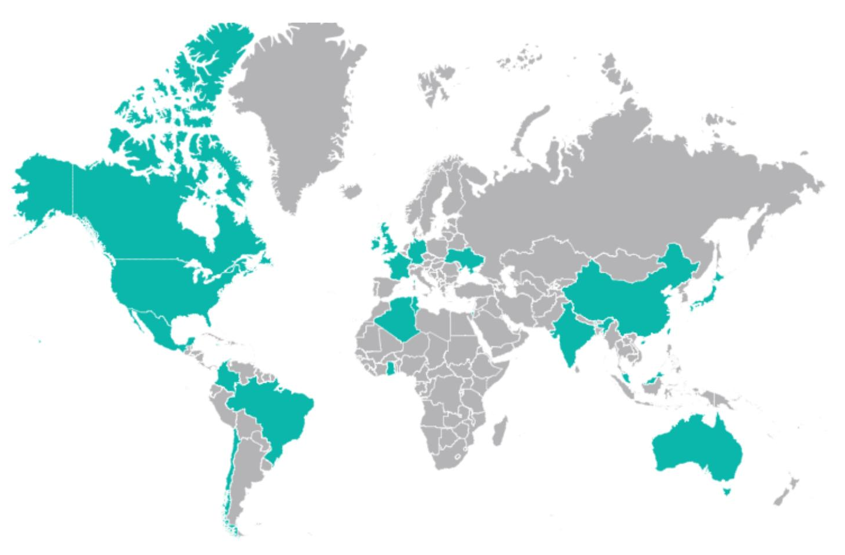
OUR GLOBAL COMMUNITY
US Cities:
Atlanta, GA
Austin, TX
Birmingham, AL
Boston, MA
Boulder/Denver, CO
Charleston, NC
Chicago, IL
Cincinnati, OH
Dallas/Ft Worth, TX
East Bay, CA
Fort Collins, CO
Greenville, SC
Los Angeles, CA
Middle East & Africa
Accra, Ghana
al-Jaza'ir, Algeria
Tel Aviv, Israel
New York, NY
Phoenix, AR
Portland, OR
Reno/Tahoe, NV
Richmond, VA
Sacramento, CA
San Francisco, CA
Seattle, WA
Silicon Valley, CA
Stamford, CT
Tampa, FL
Twin Cities, MN
Washington, DC
Wichita, KS
Americas:
Belo Horizonte, Brazil
Colima, Mexico
Kingston, Jamaica
Medellin, Colombia
Merida, Mexico
Mexico City, Mexico
Monterrey, Mexico
Recife, Brazil
Santiago, Chile
Waterloo, Canada
Asia Pacific:
Bangalore, India
Beijing, China
Brisbane, Australia
Chennai, India
Delhi, India
Gujarat, India
Hong Kong, China
Kuala Lumpur, Malaysia
Melbourne, Australia
Shanghai, China
Sydney, Australia
Taipei, Taiwan
Tokyo, Japan
Europe:
Belfast, UK
Berlin, Germany
Bristol, UK
Dublin, Ireland
London, UK
Paris, France
Vinnytsia, Ukraine
Notes:
All the places we are in

Slide 8
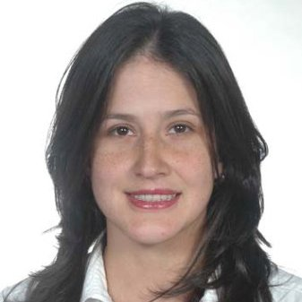
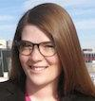


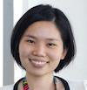

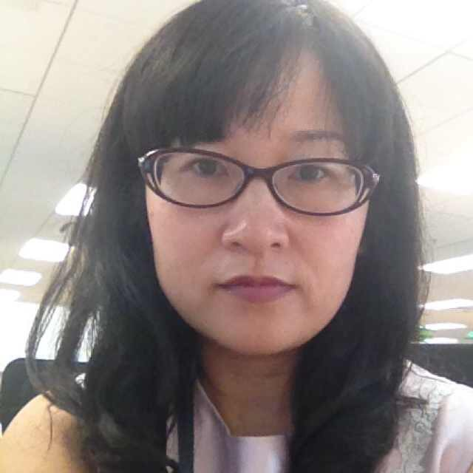
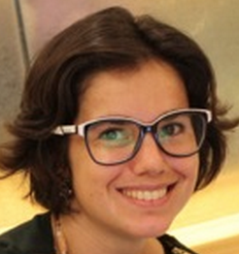

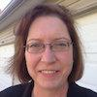
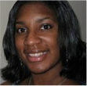


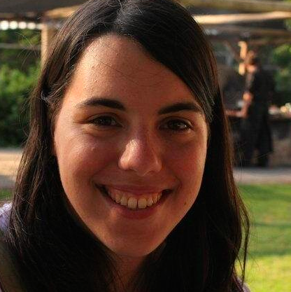

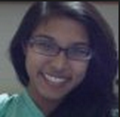

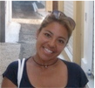

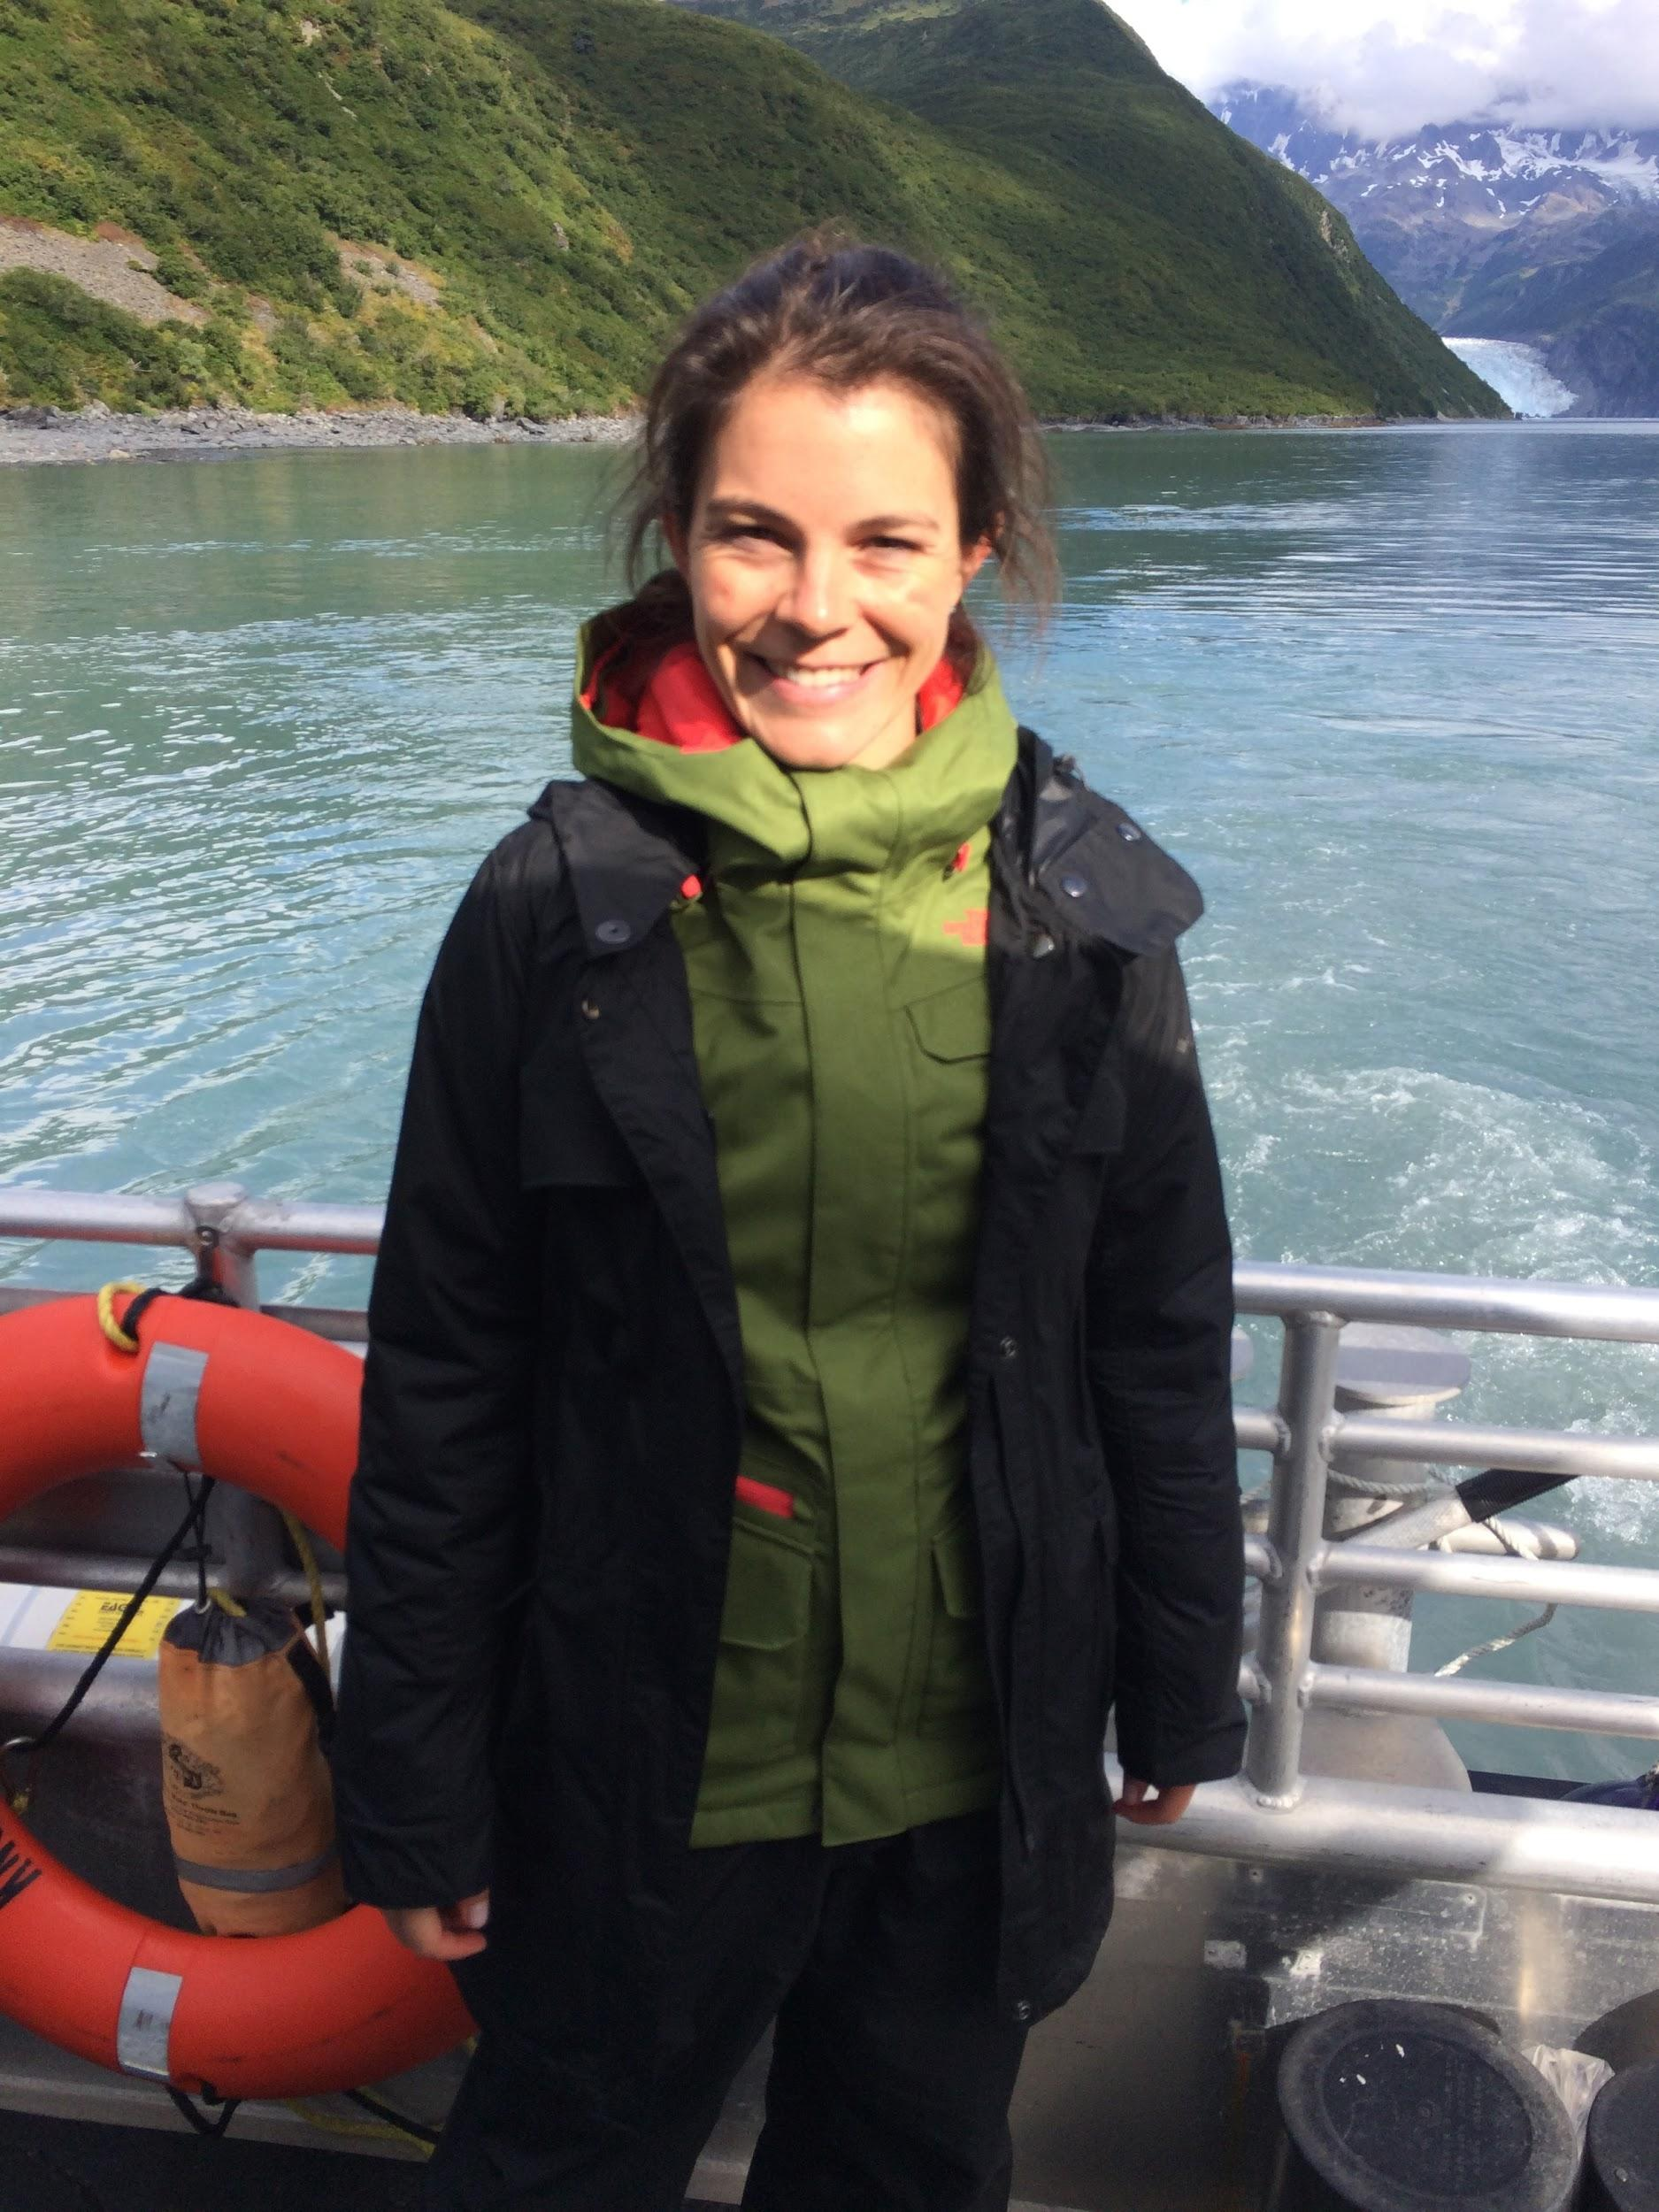


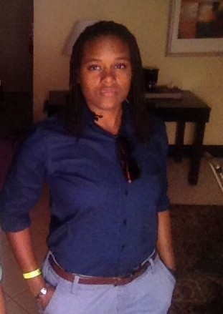

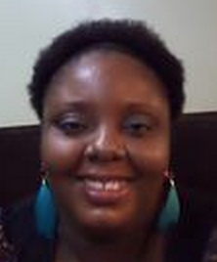



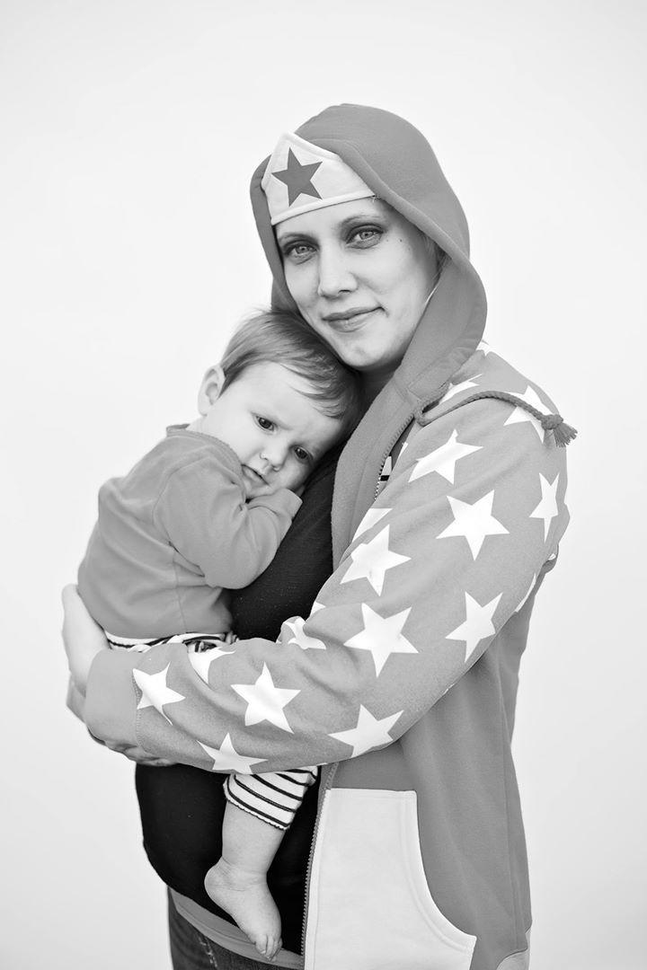

Our networks are led by 400+ volunteer leaders who help propel women in tech
Notes:
Wwcode is powered by 400+ volunteers and We couldnt bring this network together without an aweseome core team some of whom you will hear from tonight.
Request for those interested in hosting an event, presenting, helping iwth one idea or joinging our core team to connect with us

Slide 9
We help develop each others skills
Study Groups
Patterns
New Technology Trends
Networking
Hack-A-Thons
Infrastructure
Languages
UI/UX
Hands On Skill Development
Security
Workshops
Technical Talks
Dev Ops
Microservices
AND SO MUCH MORE…
PRESENTED TO WOMEN BY WOMEN
ALL ARE WELCOME
Notes:
Together we aim to provide a forum for the amazing women technologists in Richmond to teach and learn from each other… why we are here today

Slide 10
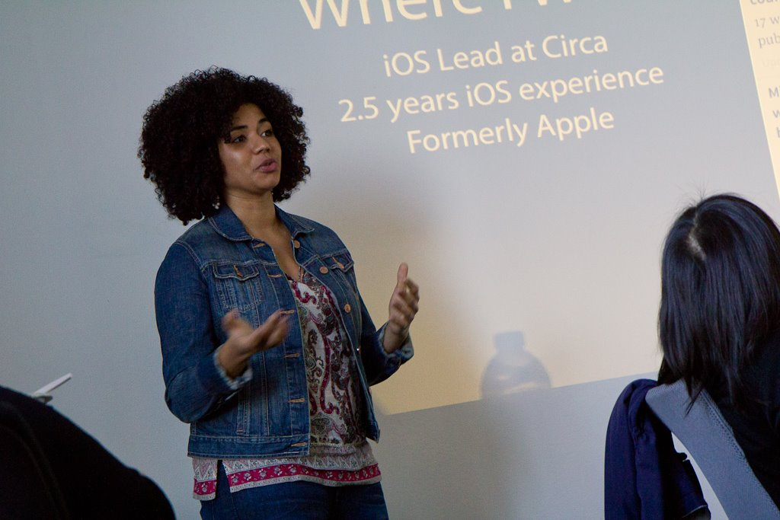
#ApplaudHer
Notes:
Women who code applaud her

Slide 11
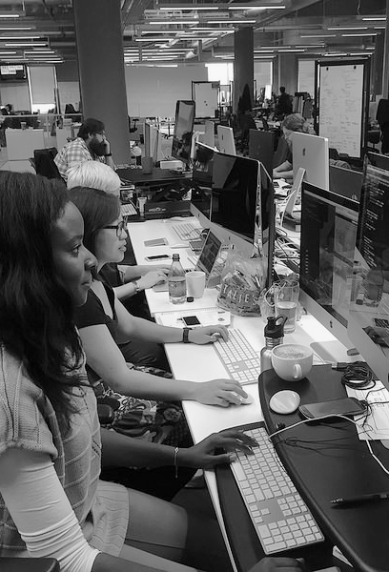
Upcoming Events
Notes:
SOOO many great events popping up in our community
Bring a laptop and a friend
Time to invest in YOU
craft an exciting skill or develop a new one

Slide 12
How to get involved!
Join Us –
Sign up today at www.womenwhocode.com
Register for meetups at www.meetup.com/Women-Who-Code-Richmond
Participate, participate, participate
Send us ideas and feedback
Lead (or help lead) a community or a single event
training, study groups, workshop, code circle
Host an event
provide space, food and Wifi
Notes:
Elisa --

Slide 13
Stay Connected!
womenwhocode.com/richmond
meetup.com/women-who-code-richmond
@wwcoderichmond
facebook.com/WWCodeRichmond
wwcrva-slack.herokuapp.com
Notes:
Elisa

Slide 14

THANK YOU!
Notes:
Briana and Michele

